Slide 1

P.B SIDDHARTHA COLLEGE OF ARTS AND SCIENCE DEPEARTMENT OF COMPUTER SCIENCE

Slide 2
SMART ATTENDANCE MANAGEMENT SYSTEM
.

Slide 3
PROJECT PRESENTATION SMART ATTENDANCE MANAGEMENT SYSTEM
UNDER THE GUIDANCE OF SUBMITTED BY:
MR.K.VEERENDRANATH SIR 1.SK. MOULALI -194333
2.K.HARISH -194315
3.T.SAI SRIKAR -194337
4.M.RAMAKRISHNA -194361

Slide 4
Contents
System Analysis:
SRS Document
Functional Requirements
Non-Functional Requirements
Data Dictionary
INTRODUCTION
EXISTING VS PROPOSED SYSTEMS
PURPOSE OF THE PROJECT
DETAILS OF USAGE
REQUIREMENTS:
SOFTWARE
HARDWARE
System Design:
Use case Diagram
Sequence Diagram
Collaboration Diagram
Class Diagram
Activity Diagram
MODULES

Slide 5
INTRODUCTION
Attendance; this has been one practice that made every work authorized and maintained in scheduled process. As time changed did the technology too, attendance registers have been taken by excel sheets, then came Bio-Metric systems and now the one you are about to know is the most recent development which is based on facial recognition system.
As the name says this system recognizes the face of the student and compares it with the preset picture data in the data base and then provides attendance.

Slide 6
Existing System
There is an old an traditional system that is even followed even now; which is manual attendance register. Later on we started to use some tools like google documents and google sheets. Then came as previously said the bio metric system of attendance. Each had its own purpose as the sole purpose of manufacturing something is to fulfil it’s purpose.
Proposed System
As introduced earlier, this system captures the face and recognizes them on comparing with the pictures in data base. If there is a question of accuracy in recognition, it is achieved by continuous testing of the facial recognition system using sample data and the software used for that was Selenium IDE which we shall discuss in future.

Slide 7
SOFTWARE AND HARDWARE REQUIREMENTS
HARDWARE:
A SERVER , WHICH IS GENERALLY A PC THAT HAS A COMPATIBILITY TO TAKE A LOAD, MINIMUM OF I5 PROCESSOR OR AN AMD RYZEN 5 AND ALSO THAT HAS A CAMERA AVAILABILITY
SOFTWARE:
SELENIUM IDE, SUBMILME TEXT, PYTHON 3, DJANGO, ASGIREF, PYTZ, TINYURL, OPENCV, SQLPARSE.GITHUB, STATIC CODE ANALSYSIS – SONARQUBE.

Slide 8
SRS: Software Requirement Specification
Purpose:
To make the present attendance system a smarter one.
Document Conventions:
Syntax Conventions:
Conventions | Description
Courier New | The code part is written in Courier New font
Italic | All of the CSS part is written is italic font
<> | As always all the HTML code is written in between <>
# | # symbol is used to make the code part a comment in both HTML and Python.
{} | Used to make the usernames dynamic

Slide 9
Naming Conventions
Conventions | Description
c, ass, assc | All the data base objects are defined using the variable ‘c’, ‘ass’, ‘assc’
D3(Module) Conventions
Conventions | Description
Login | This term refers to the login using the given username and respective passwords.
View Attendance | This term refers to view attendance in the particular login.
Marks | To view/give marks based on type of login.
Generate reports | To generate the student reports in teacher login.

Slide 10
System Analysis
Functional Requirements:
Business Requirements: To change the traditional way of taking attendance into a smarter way.
Administrative Functions: Every update that is done must be reported by the system.
User requirements: The system must be able to do the required functions that are assigned to different logins.
System Requirements: The devices that are connected to the server must be able to login using the IP address and then can use the service.
Non- Functional Requirements:
Usability: The system is made responsive even on mobiles thus making the user interface comfortable enough.
Availability: The uptime requirements are clearly met, as an educational institution runs for a whole academic year, it is available.
Performance: The performance can be divided as the facial recognition part and the response time, where the response time is less than 1 second and the facial recognition has been trained using more than 1000 samples of photos thus making it accurate.
Supportability: Supported on any device.
Security: The unique IDs and logins make it secure.

Slide 11
FUNCTIONAL REQUIREMENTS
USER STORY | STATUS
Teacher must be able to login | Requirements Met
Teacher must be able to change attendance | Requirements Met
Teacher must be able to view time table | Requirements Met
Teacher must be able to change time table | Requirements Met
Teacher must be able to generate reports | Requirements Met
Teacher must be able to change the marks | Requirements Met
Teacher must be able to change time table | Requirements Met
Teacher must be able to create an extra class | Requirements Met
Teacher must be able to assign substitute | Requirements Met

Slide 12
FUNCTIONAL REQUIREMENTS
USER STORY | STATUS
Student must be able to login | Requirements Met
Student must be able to view marks | Requirements Met
Student must be able to view time table | Requirements Met
Student must be able to see subject-wise attendance | Requirements Met
Student must be able to give attendance | Requirements Met
Camera availability | MUST BE THERE
The student’s camera must be turned on automatically | Requirements Met

Slide 13
NON-FUNCTIONAL REQUIREMENTS
USER STORY | STATUS
UI must be responsive on any device | Requirements met
Uptime must be all the time school/college runs | Requirements met
HD camera is not required | Requirements met
Login details need be changed(but to be asked to admin) | Requirements met

Slide 14
Data Dictionary
Attribute Name | Required | Data Type | Max Field Size | Description | Example
Class_ID | Yes | String | N/A | Class that is to be added or accessed | MSDS
Dept_ID | Yes | String | N/A | Department that the class is to be added | Data Science
Section_ID | Yes | String | N/A | Section of the added class | MSDS(A)
Sem_ID | Yes | Integer | 1 character | Semester that the class is added for | 4
USN_ID | Yes | String | N/A | User name to login which is dynamic | varaprasad

Slide 15
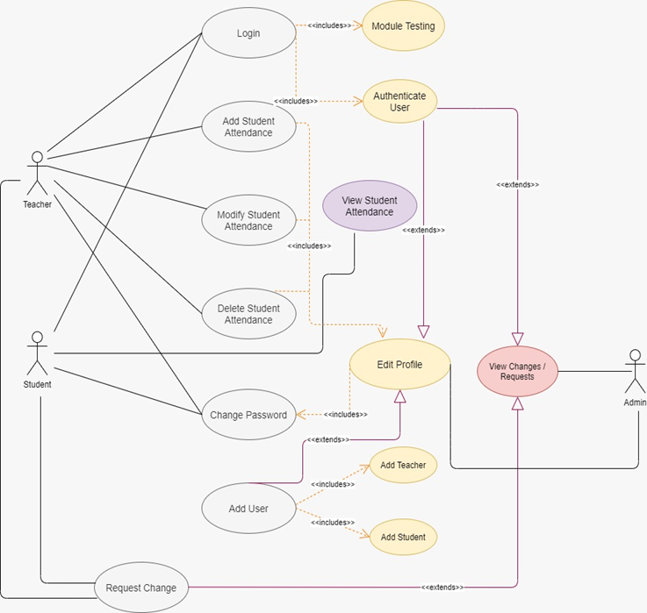
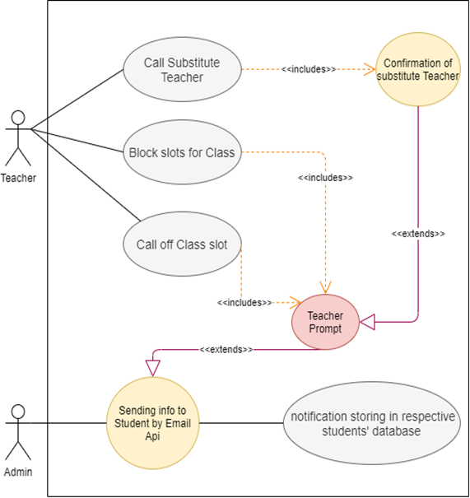
Administration Use Case Diagram
Free Hour Incorporation Use Case Diagram

Slide 16
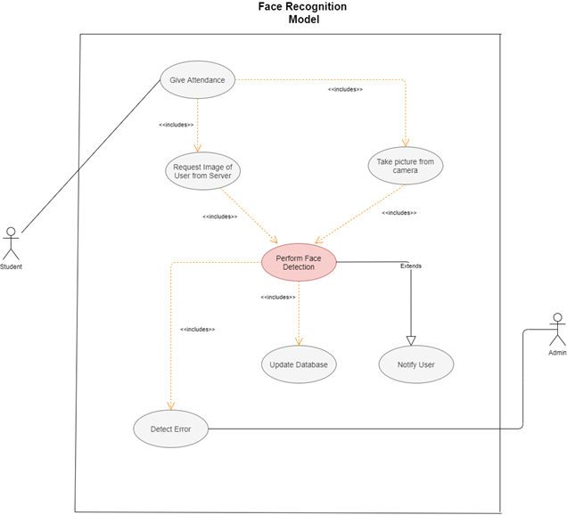
Face Recognition Model Use Case Diagram

Slide 17
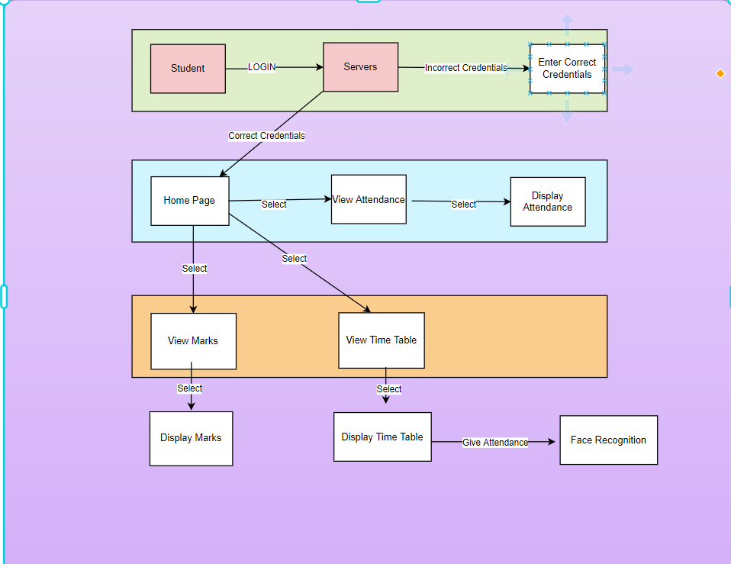
Student Collaboration Diagram

Slide 18
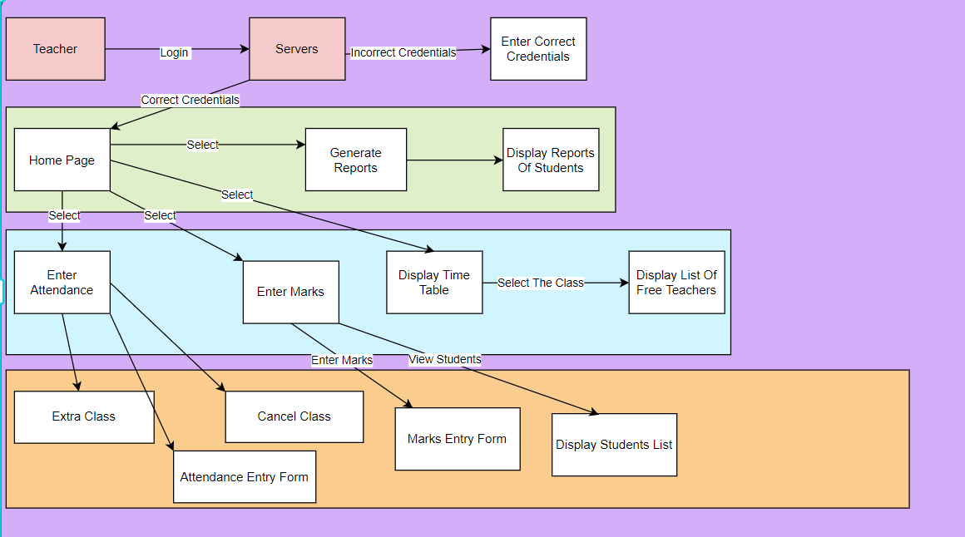
Teacher Collaboration Diagram

Slide 19
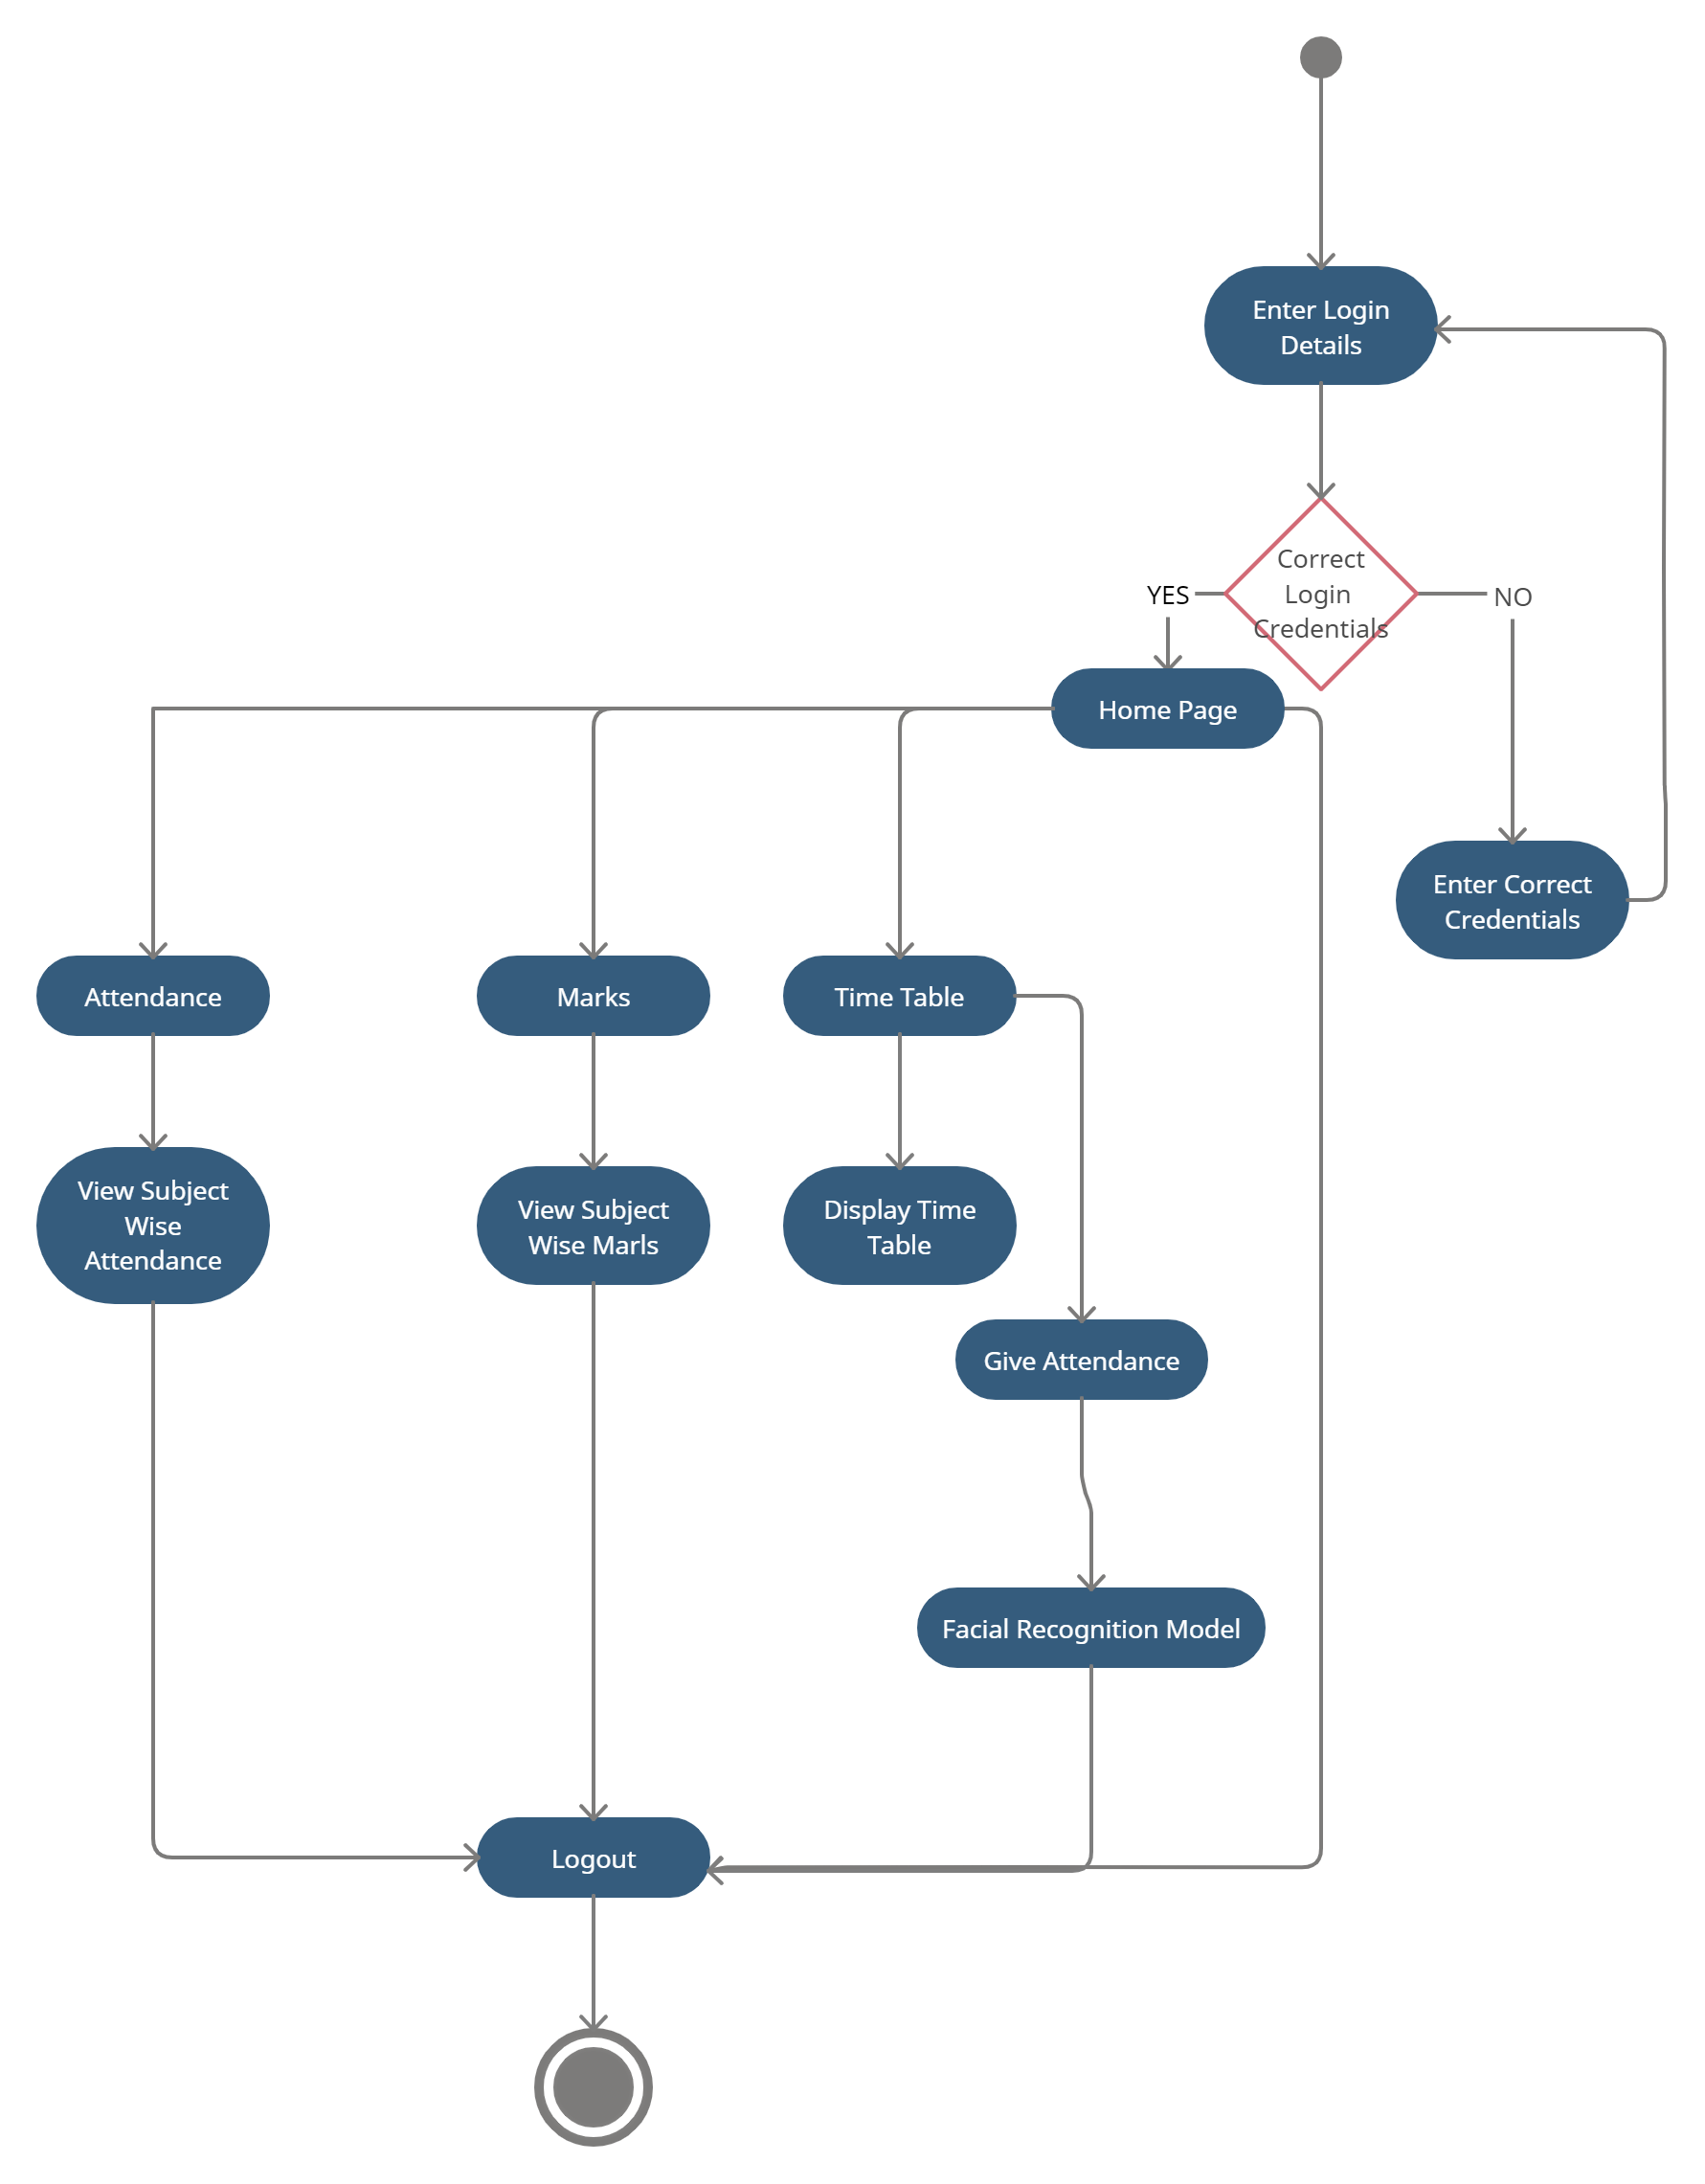
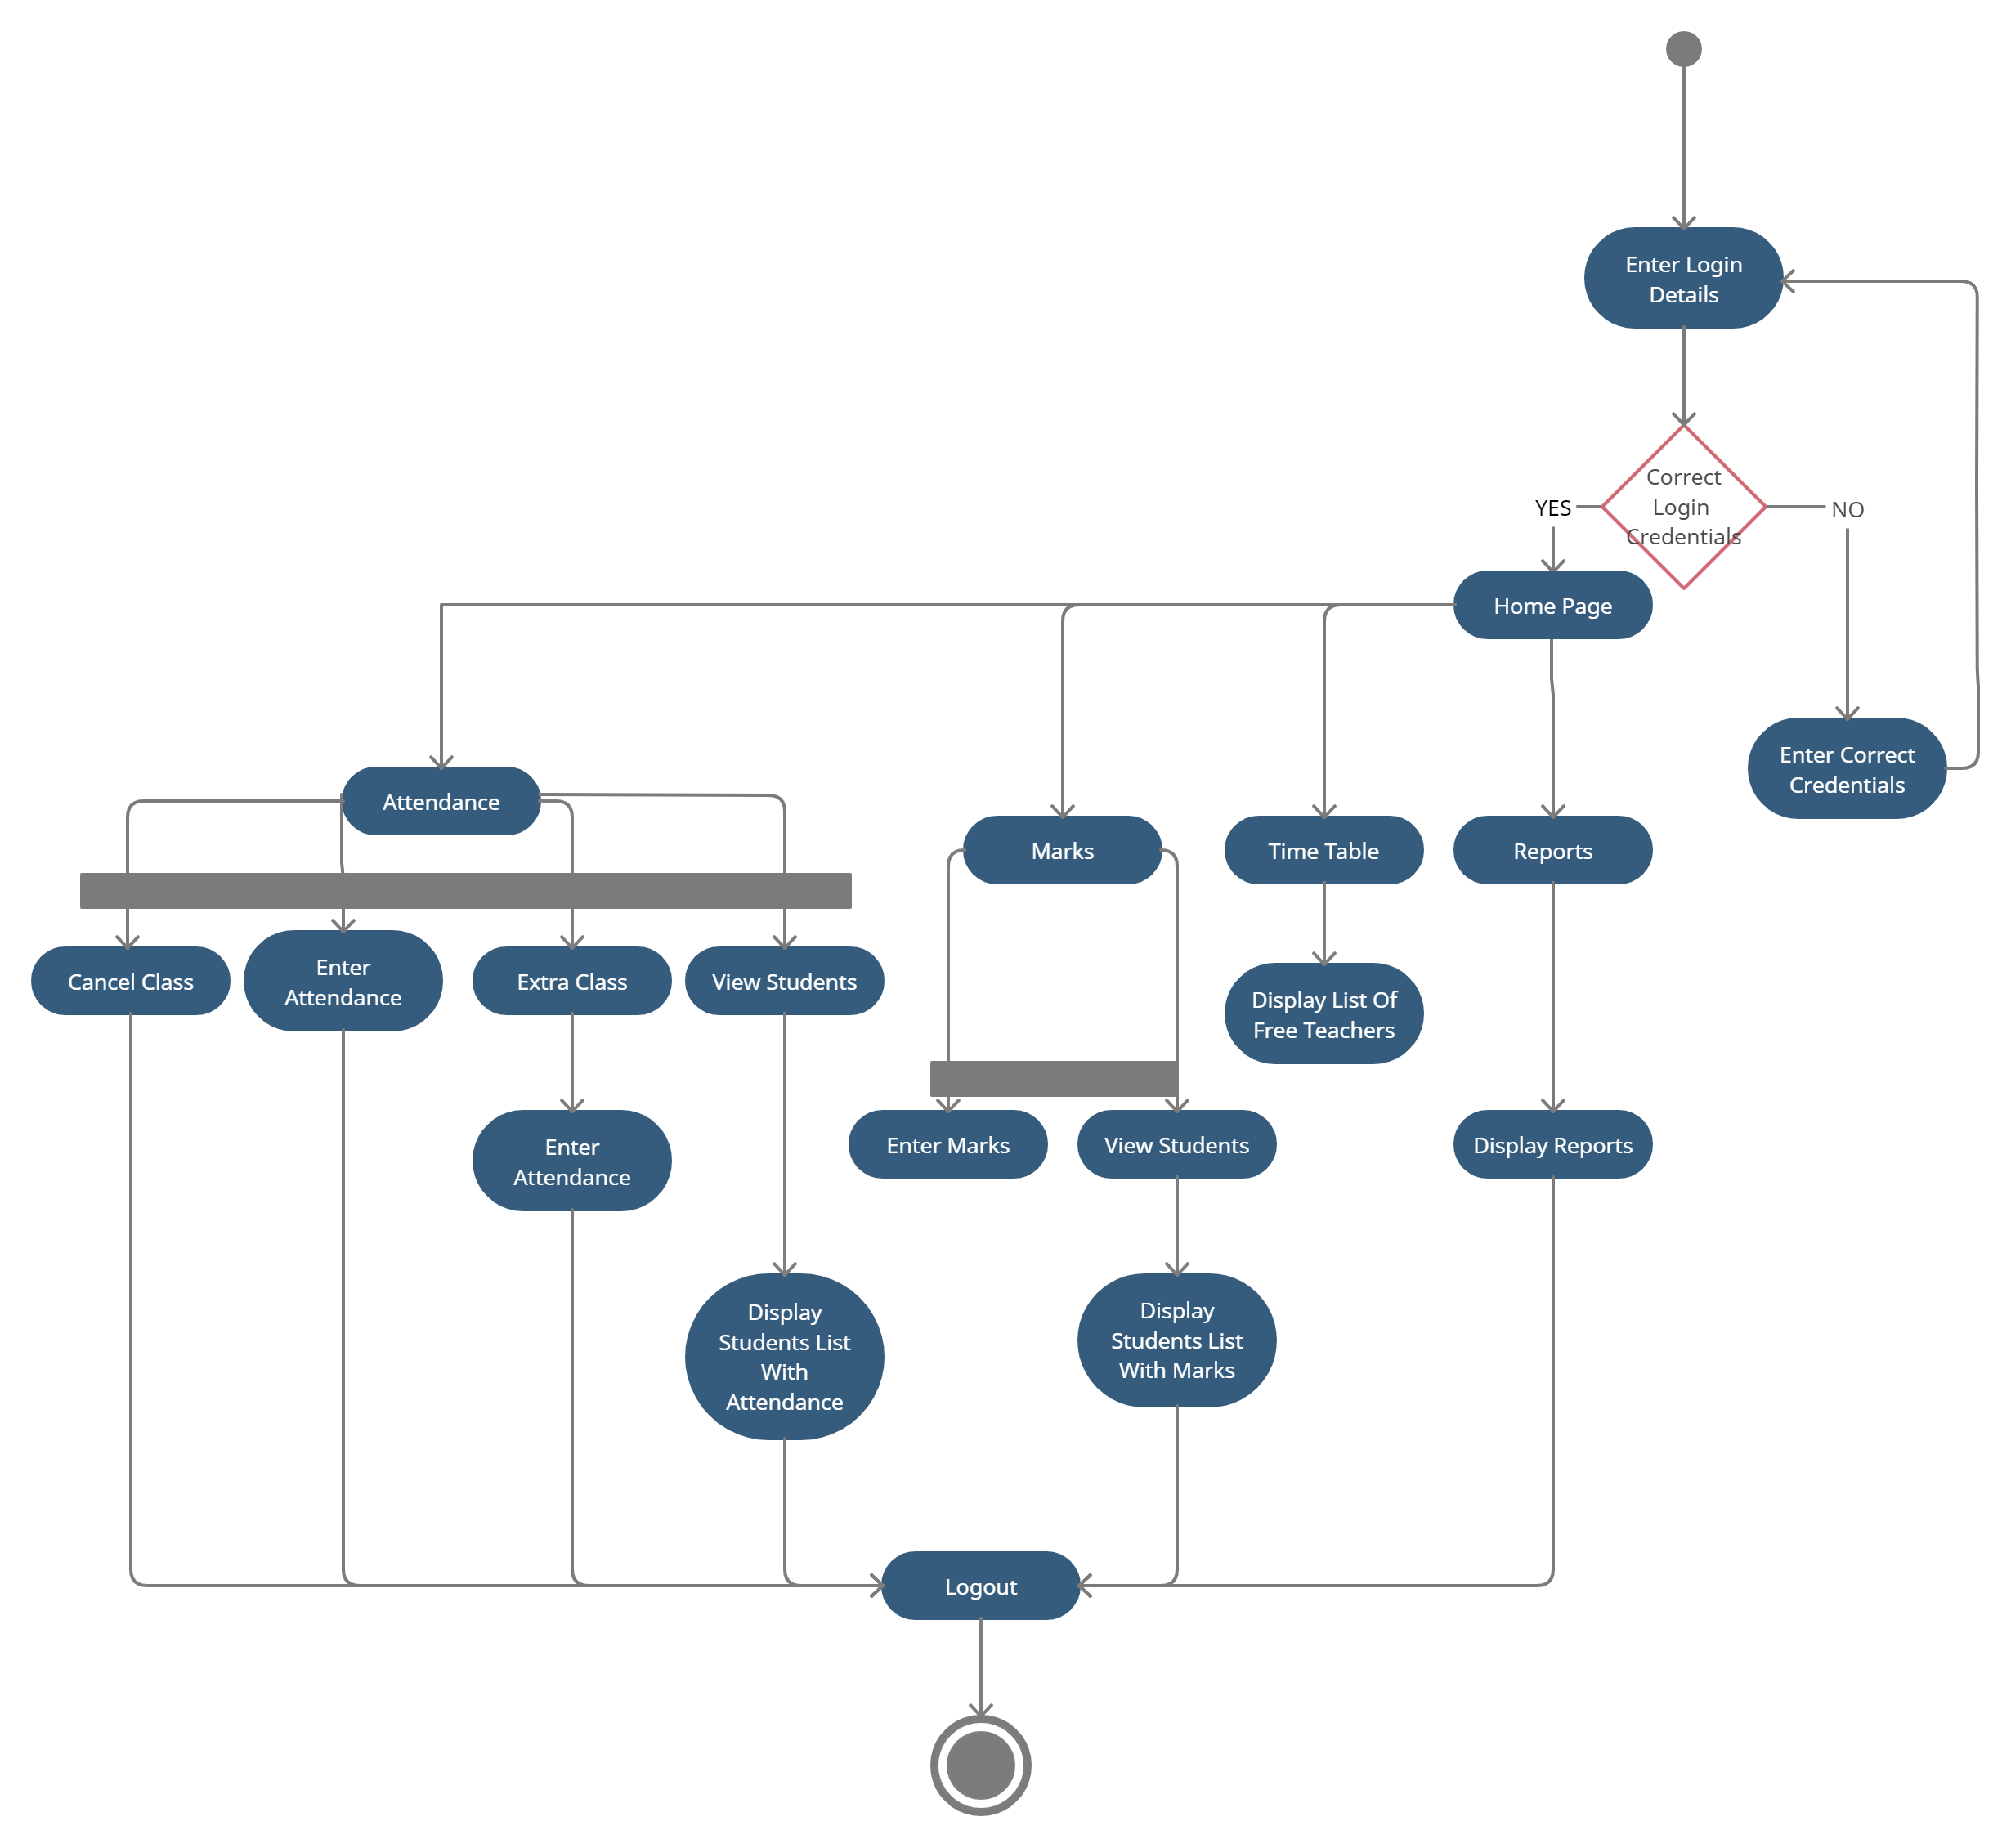
Student Activity Diagram
Teacher Activity Diagram

Slide 20
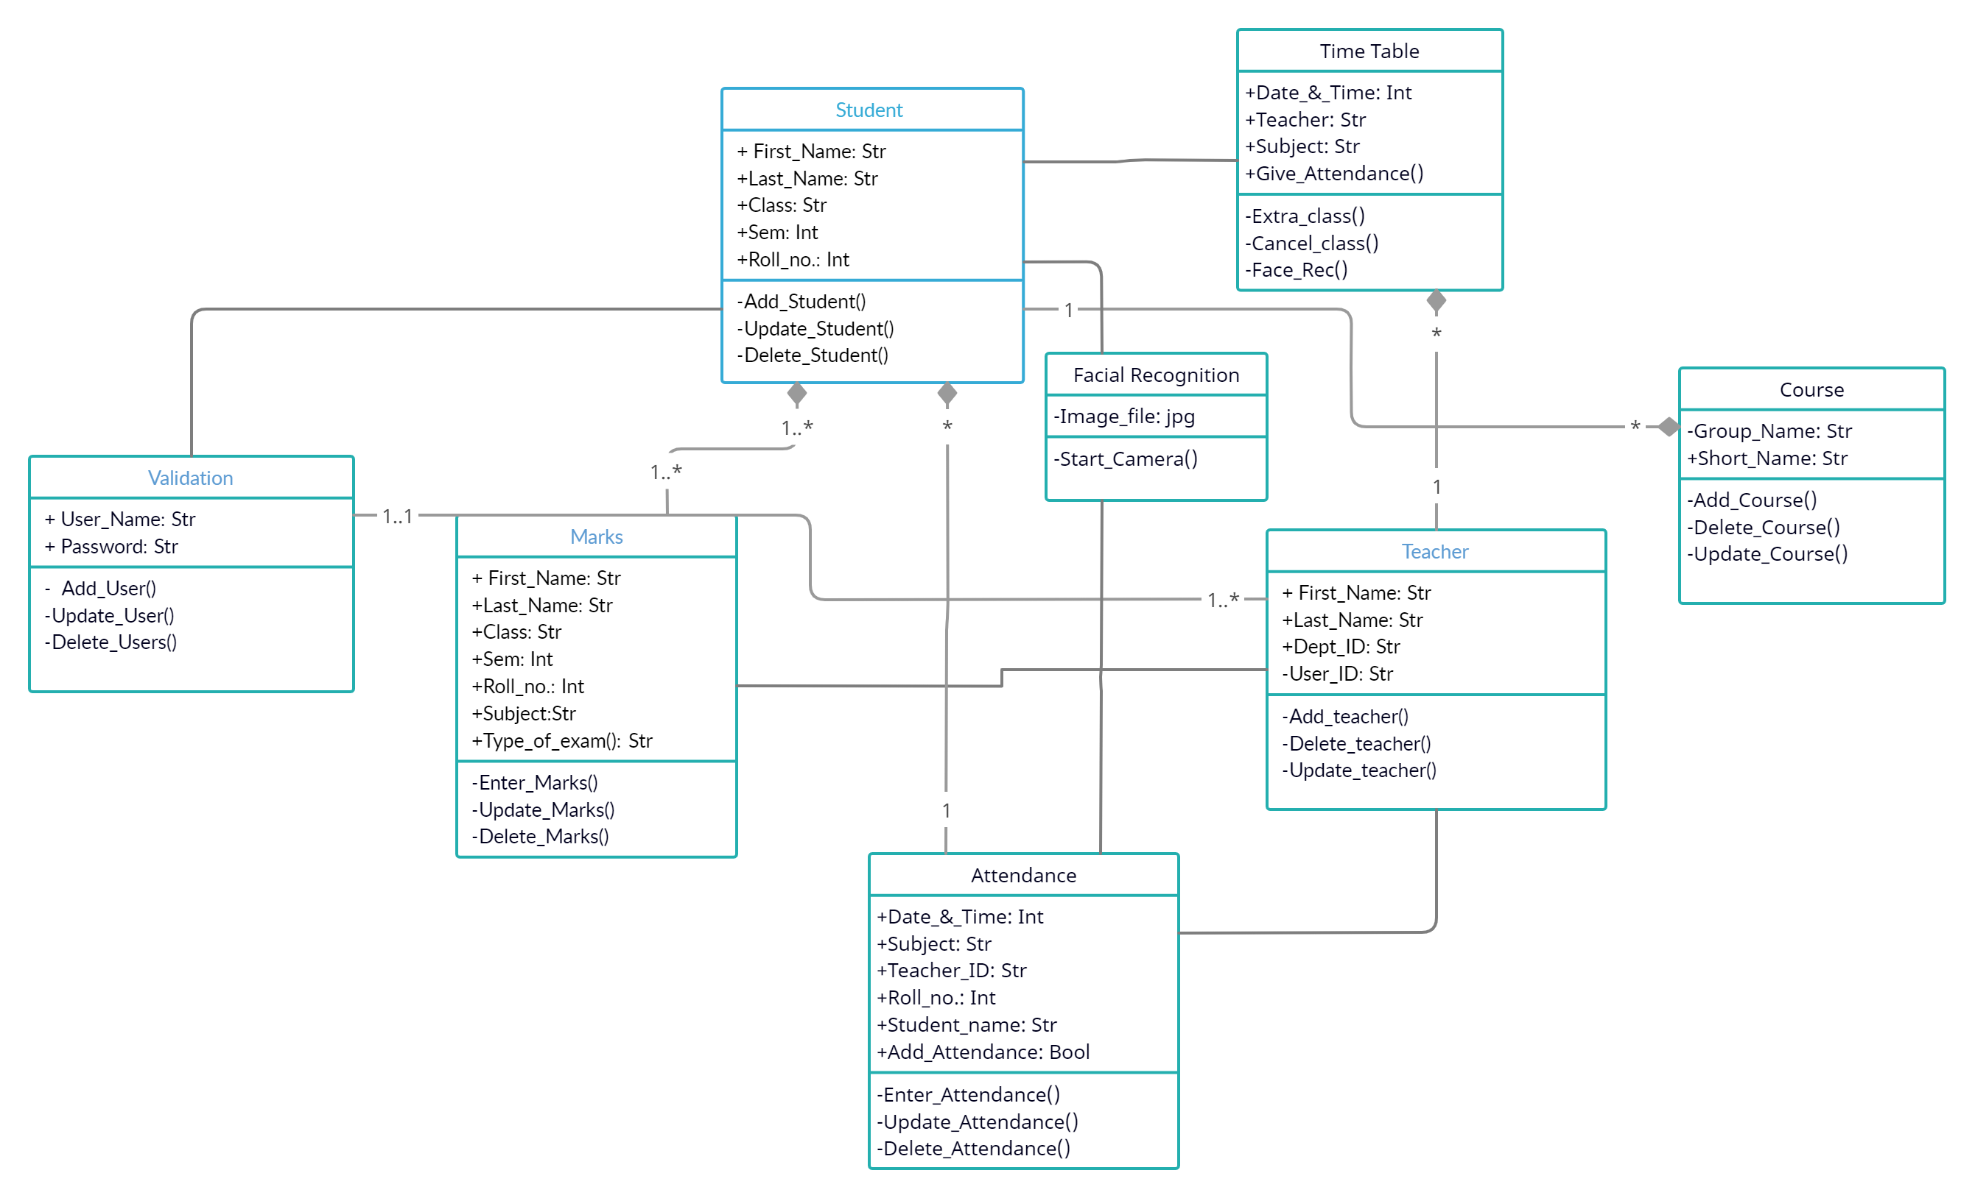
Class Diagram

Slide 21
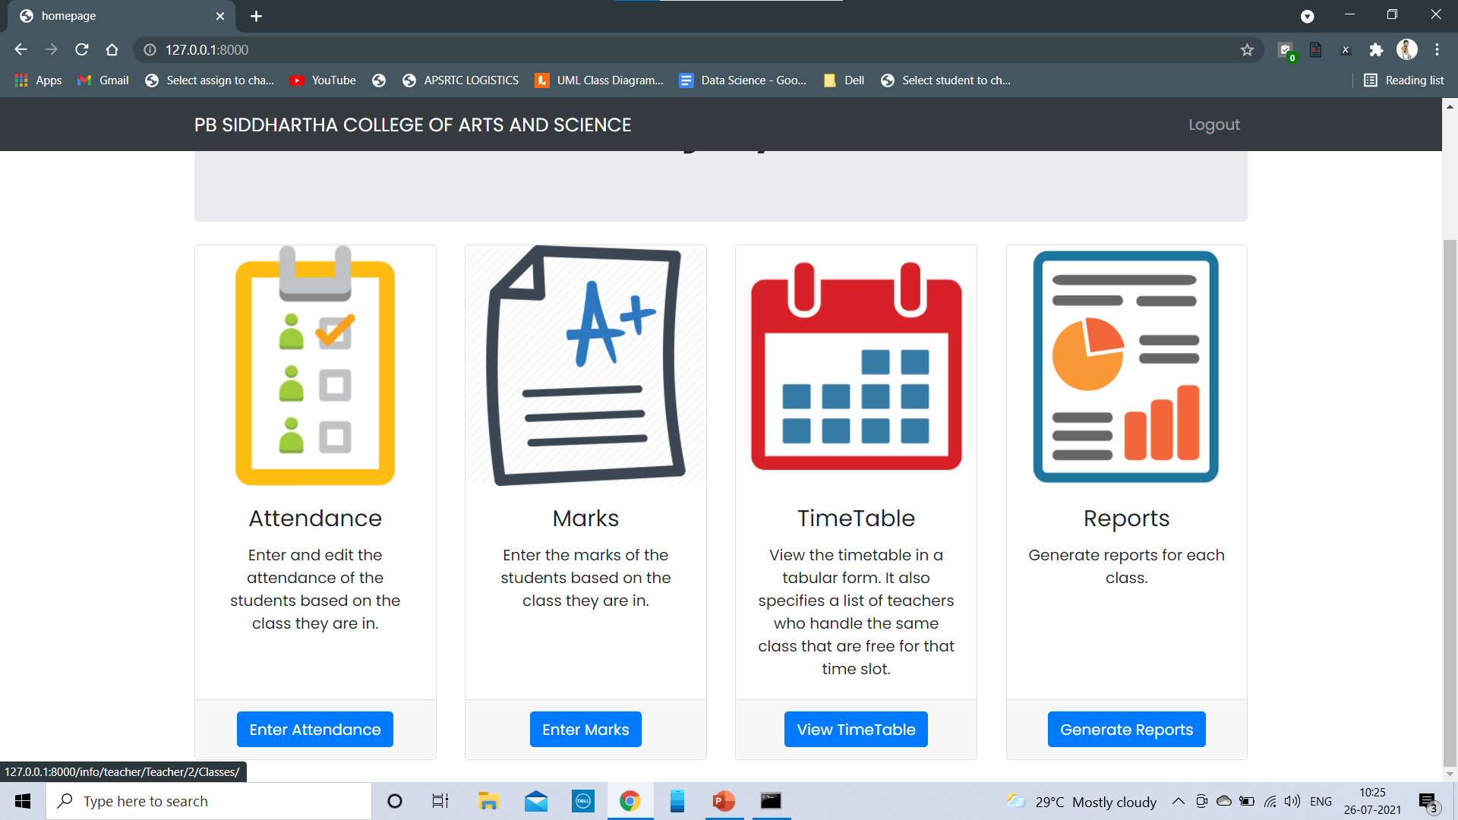
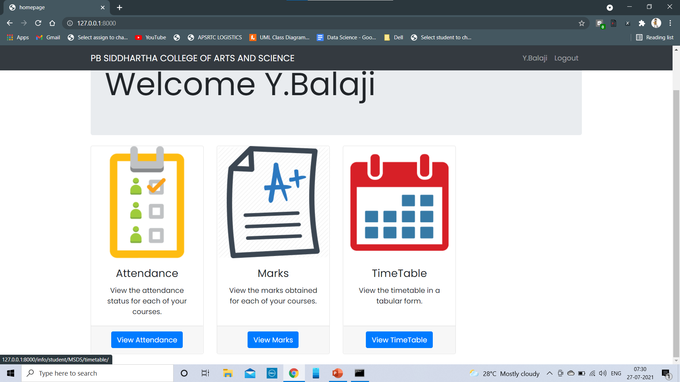
Teacher Home Page
Student Home Page

Slide 22
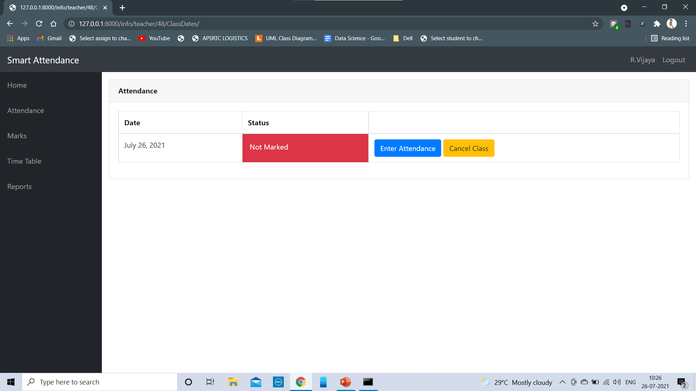
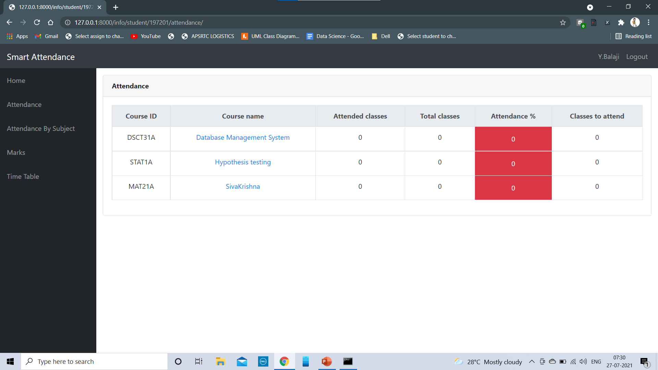
Teacher’s Give Attendance Page
Student’s View Attendance Page

Slide 23
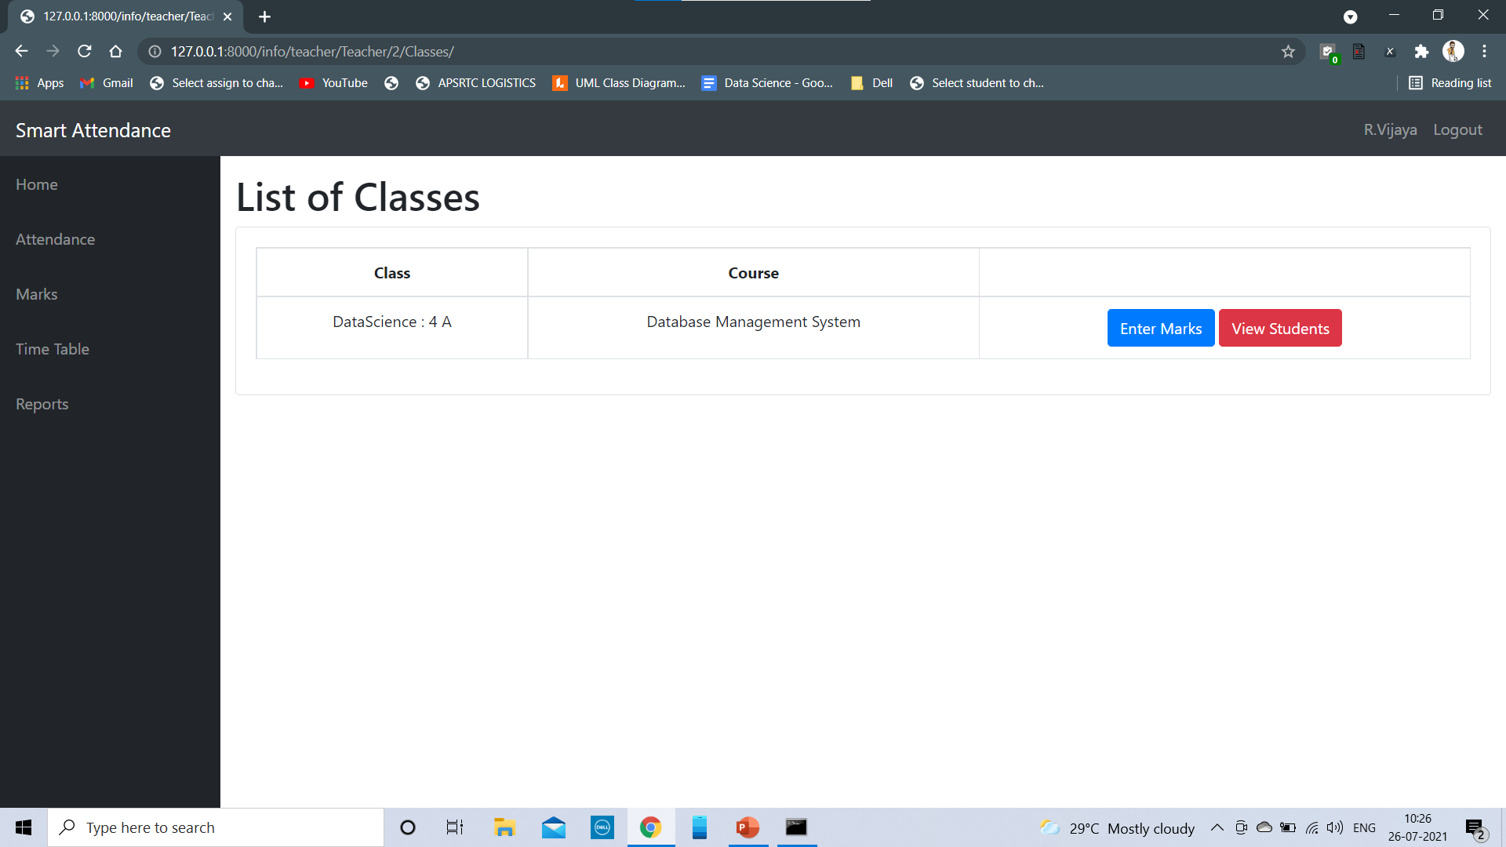
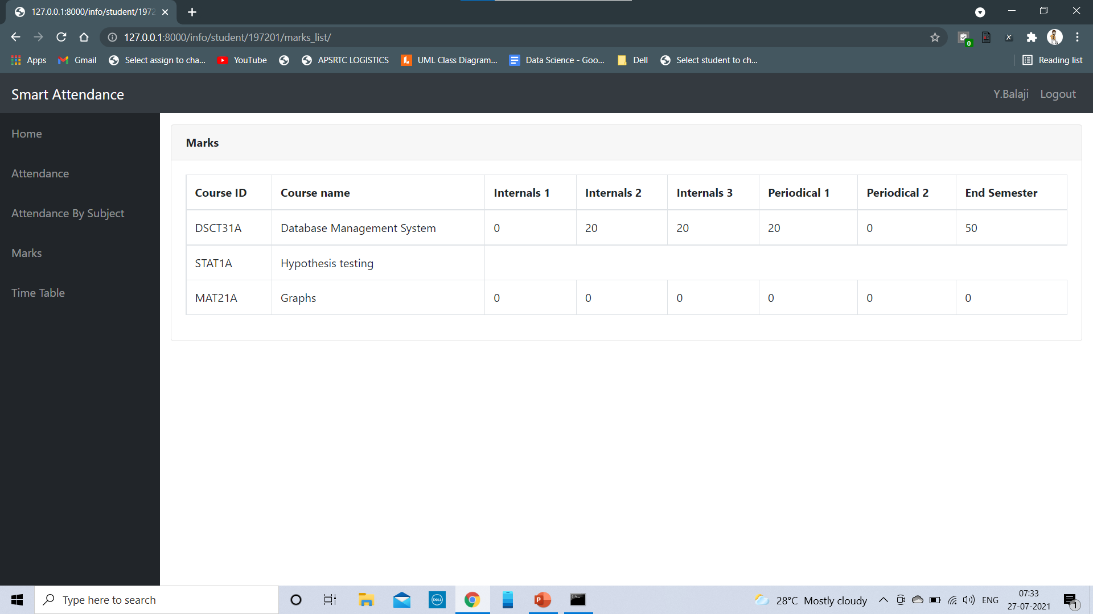
Teacher Enter Marks
Student View Marks

Slide 24
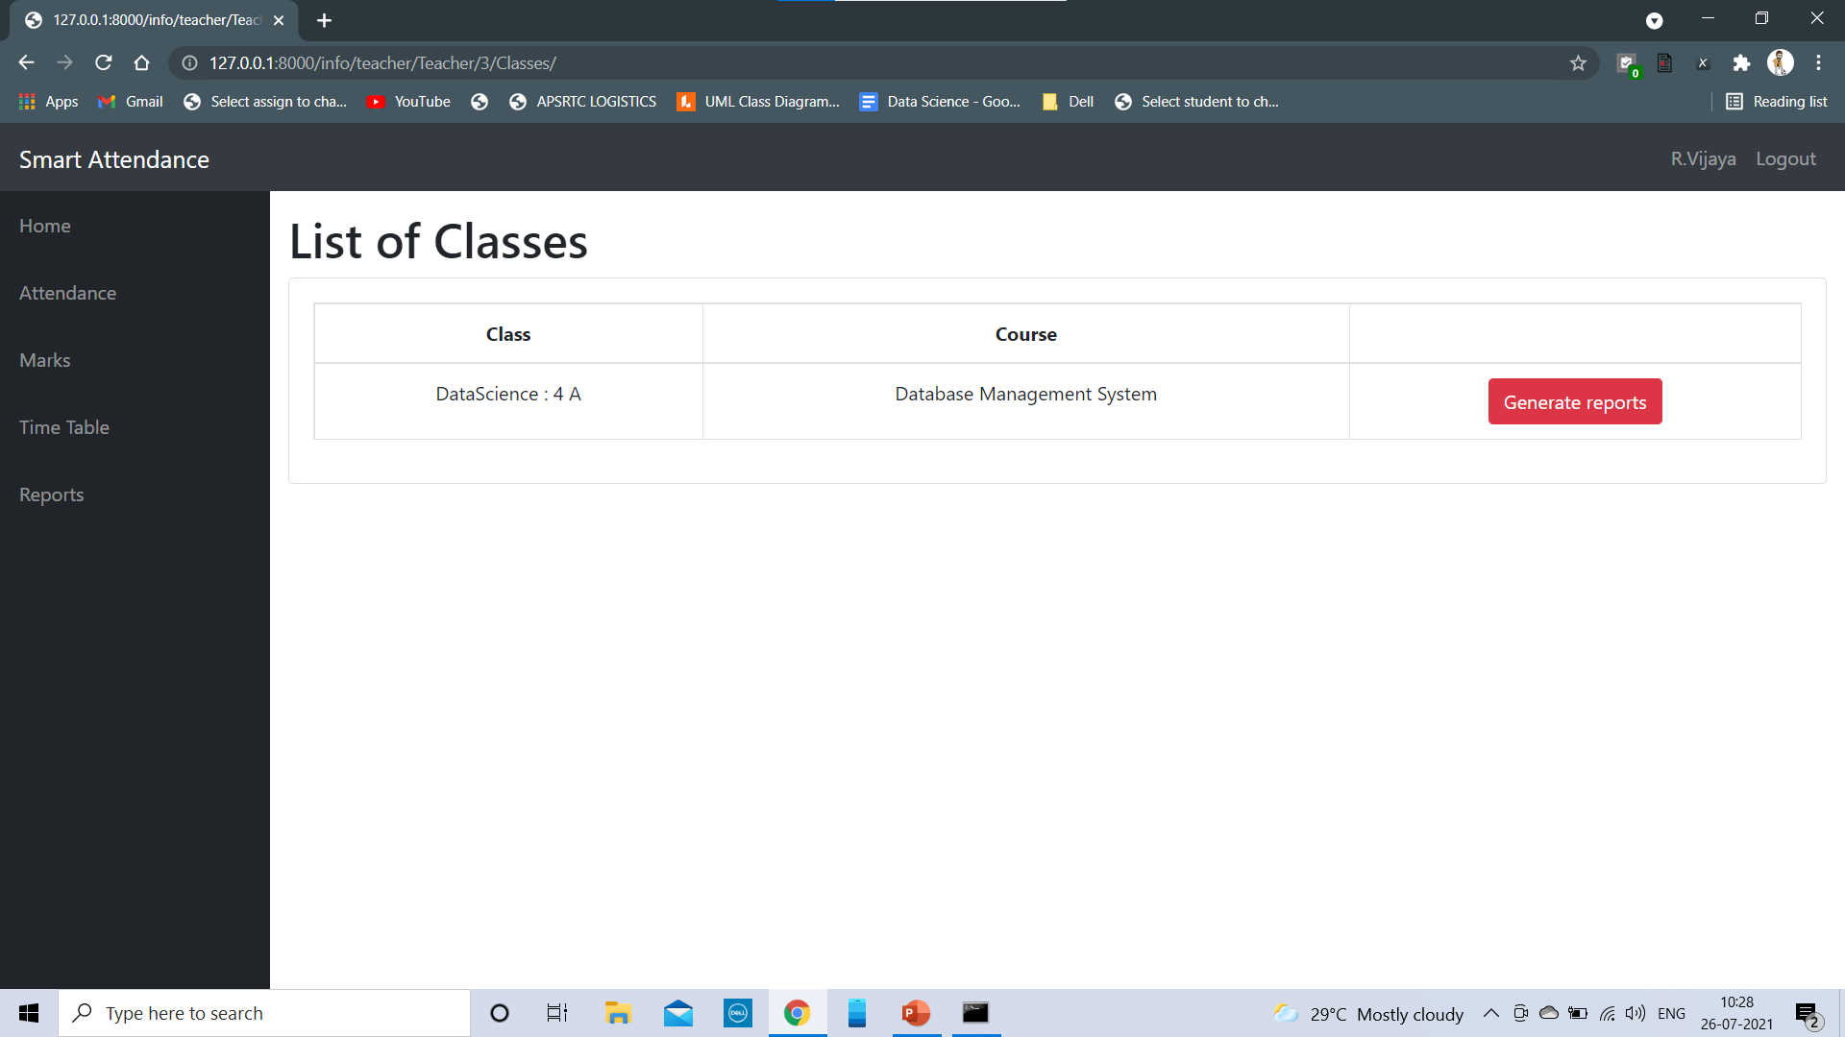
Teacher Generate Reports
Student View Reports

Slide 25
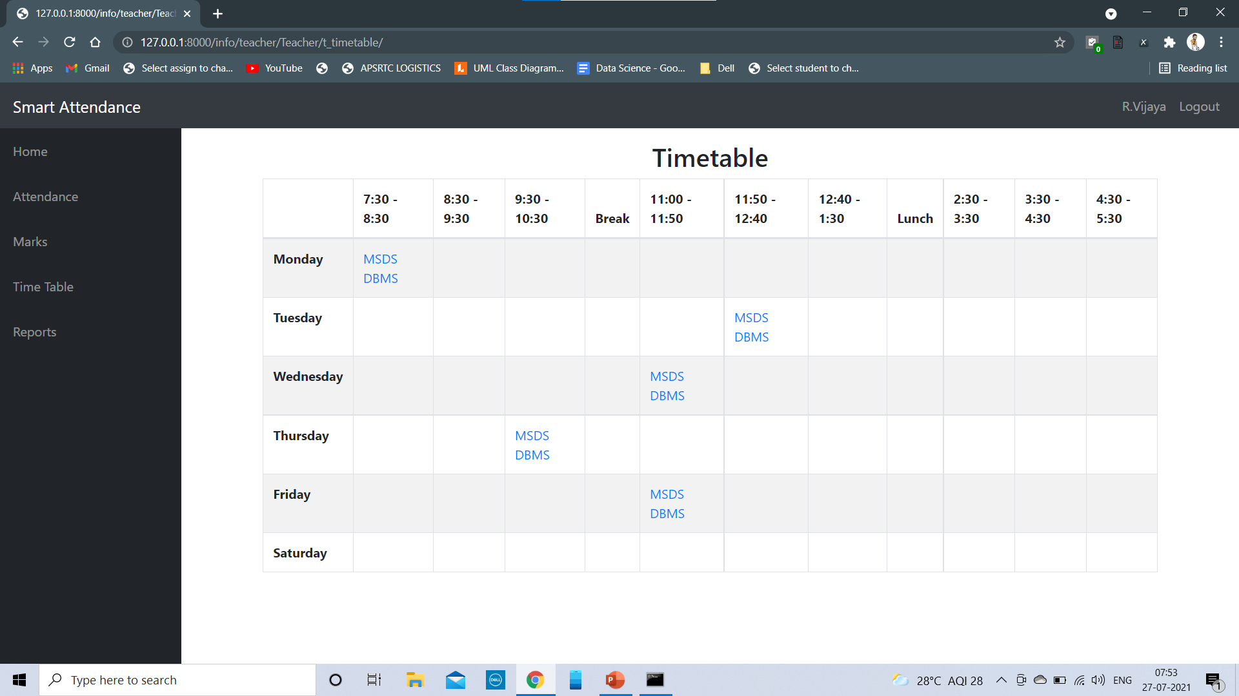
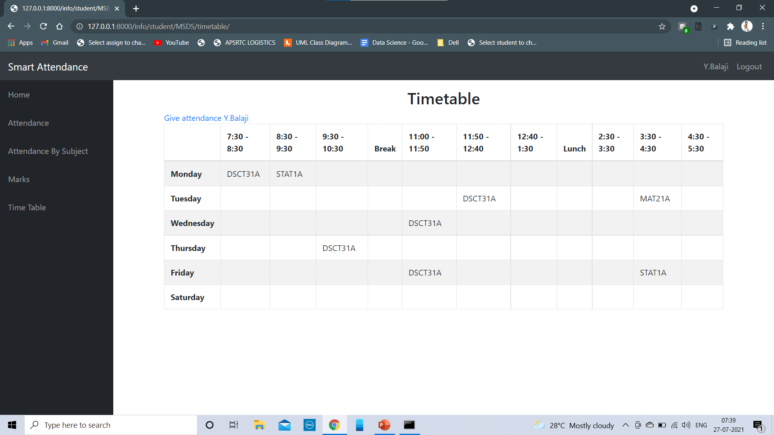
Teacher Time Table
Student View Time Table

Slide 26
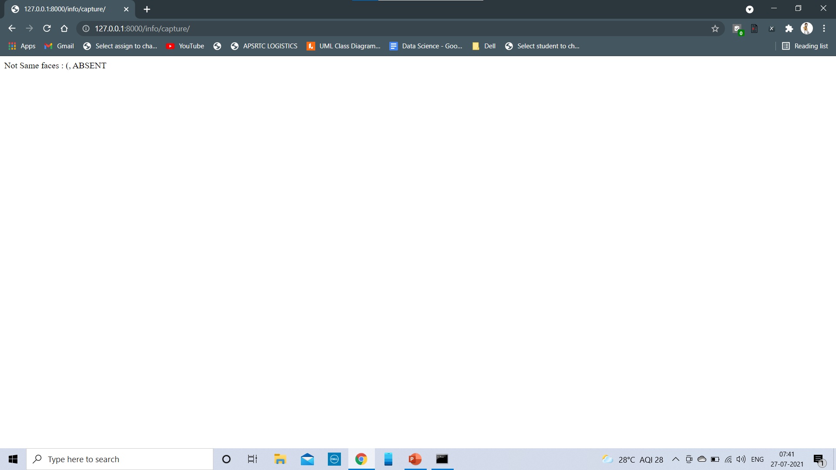
Student Give Attendance Page(Facial Recognition Page)

Slide 27
Thank You

